Slide 1
Research Computing Update
February 2021

Slide 2
HPC Resources
New HPC Procurement via ANKABUT
Hardware installation completed and being configured
A number of issues with configuration, that required support from vendors, e.g. cable not working, updates to firmware, storage issues.
Expect to start user testing late March to early April
SAN HPC Cluster
SAN HPC cluster was due to be decommissioned by end of January 2021, but has been pushed back
Quote for the decommissioning of hardware with ADNOC now, awaiting their decision

Slide 3
Resource Utilization

Slide 4
KU Cluster core distribution

Slide 5
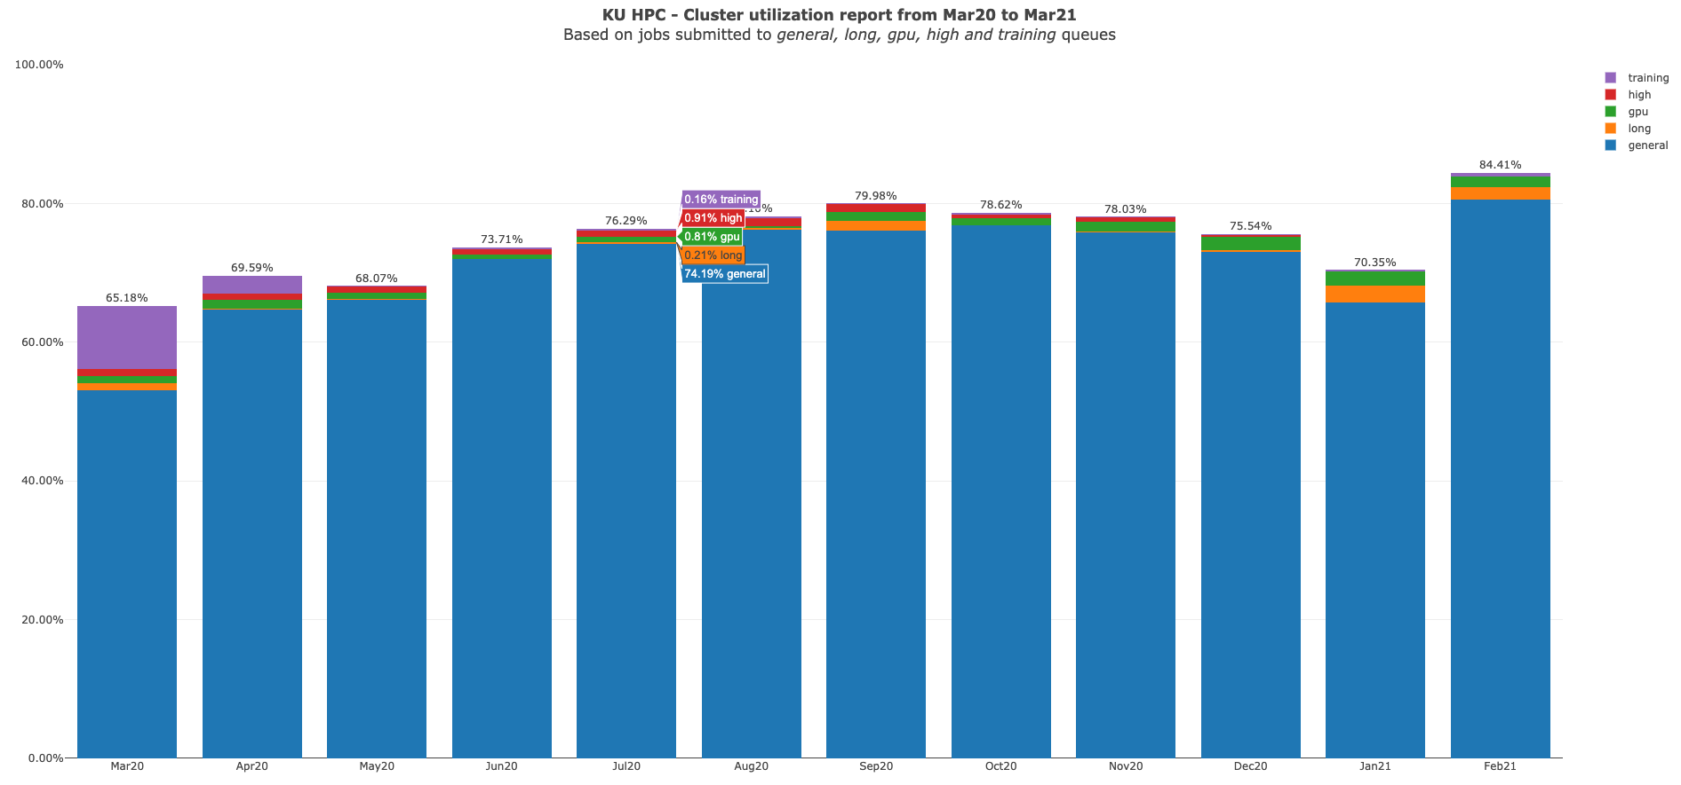

Slide 6
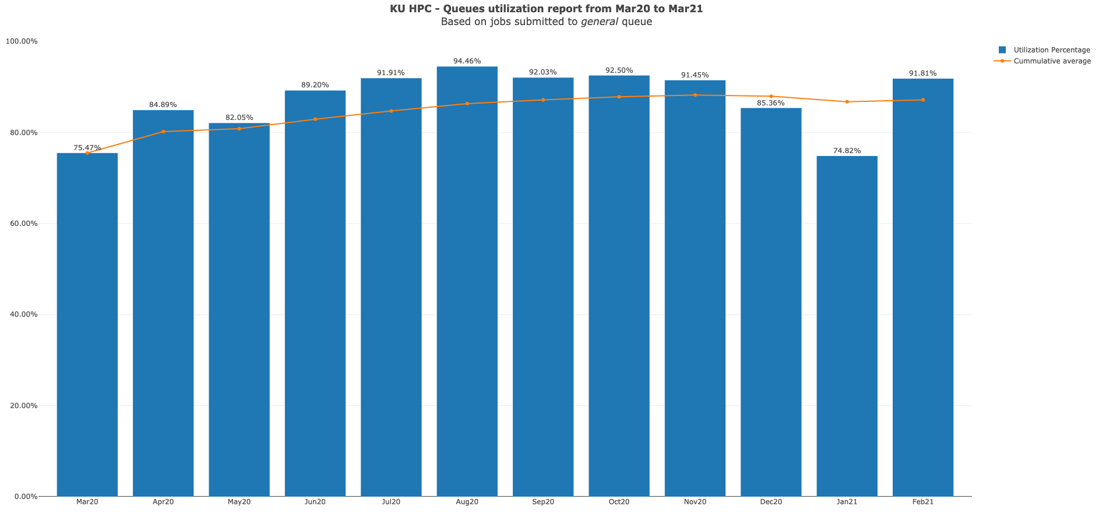

Slide 7
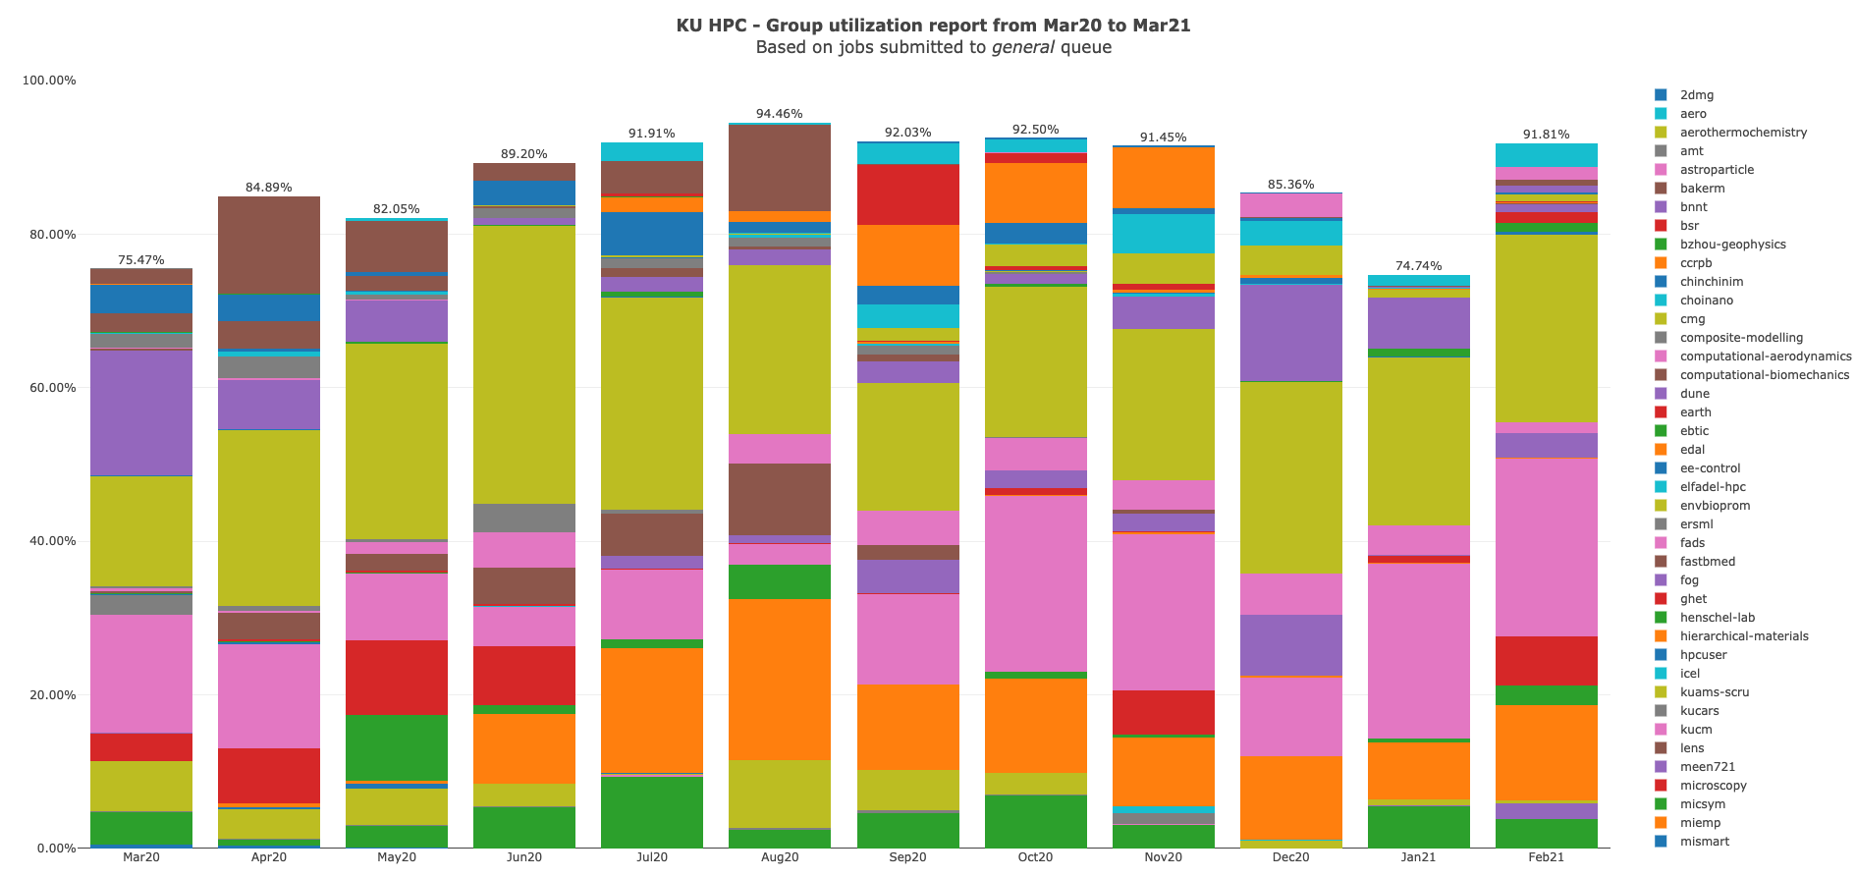

Slide 8
KU HPC Group Utilization for February 2021.
Note that do not yet keep track of applications used automatically. This is a work in progress, and will be added to future reports.

Slide 9
PI Cluster core distribution

Slide 10
